Slide 1


Short Answer Question

Slide 2
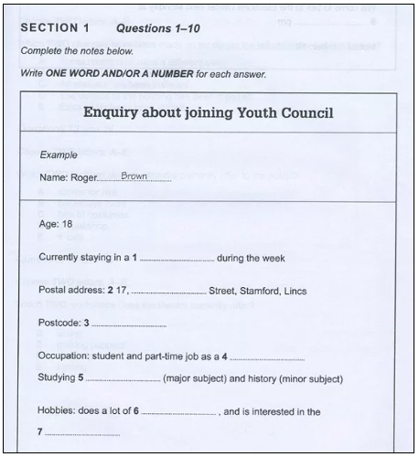
Form
Completion

Slide 3
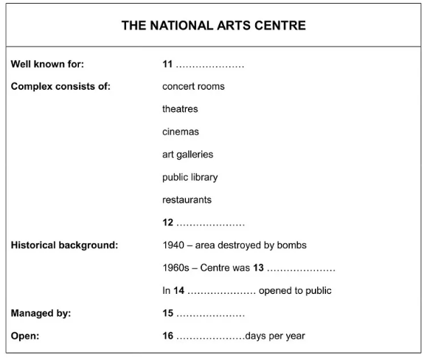
Note Completion

Slide 4
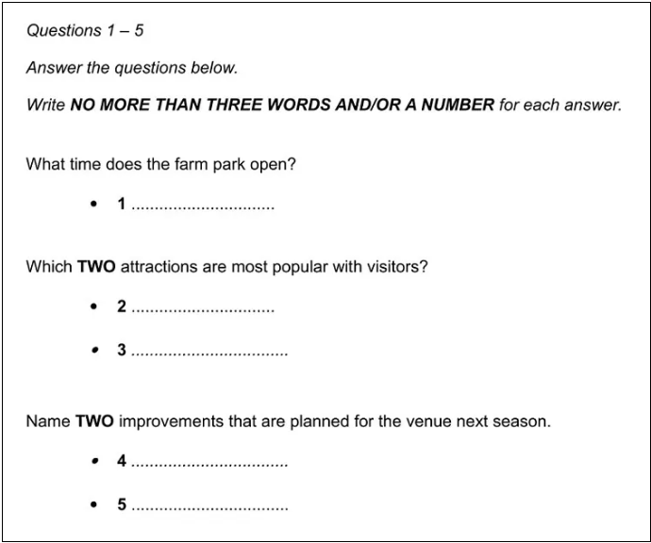
Short Answer Question

Slide 5
Read the Instructions
The instructions for our sample question state that you must,
Write NO MORE THAN THREE WORDS AND/OR A NUMBER for each answer.
If you write more than three words, your answer will be marked incorrect even if the information you give is correct.

Slide 6
Look for a Title
Not every question will have a title but if there is one, it will tell you the context of the question. Our sample question has the title ‘Enquiry about joining Youth Council’.
Knowing the context gives meaning to the information in the notes. This will help you to understand the question and give you a big clue as to what sort of information will be contained in the recording.

Slide 7
Predict the Answers
Try to predict what the answers might be. This will focus your mind on what to listen out for in the recording.
Occasionally, you’ll be able to predict the actual word but mostly it’s one of these things that you’ll be able to determine:
The type of information required, e.g. surname, place name, date, phone number, postcode, percentage, price.
The type of word required, e.g. noun, adjective, verb.
The answers to form completion questions will usually be factual information such as that listed in the first bullet point above.
Any clues you can get will help you to understand the recording and identify the information needed for the answers.

Slide 8
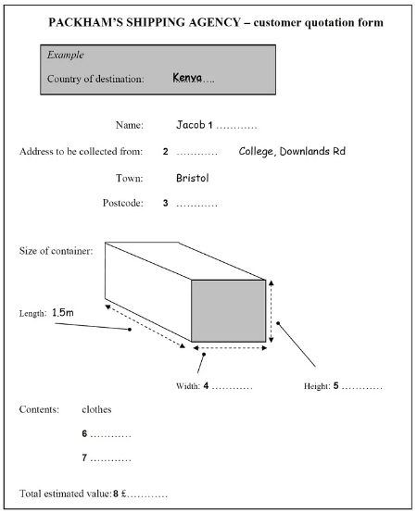
Predictions:
1 – a surname
2 – the college name
3 – a postcode made up of letters and numbers
4 & 5 – numbers of measurement
6 & 7 – nouns (items in the box)
8 – numbers written as a price

Slide 9
Predictions:
11 – ?
12 – the name of a room or facility
13 – a verb in the past tense
14 – a date
15 – the name of a business or organization
16 – a number

